Slide 1
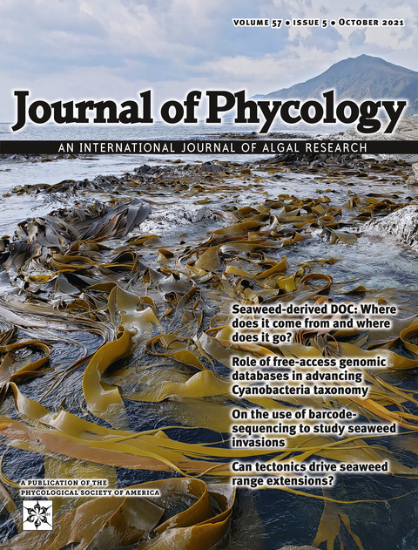
Join the Phycological Society of America!
Ecology Evolution Cell Biology Physiology Oceanography Genetics
Biomechanics Taxonomy Chemistry Aquaculture Conservation Microbiology
www.psaalgae.org
IDEA committee actively working on inclusion, diversity, equity, and access
Students
Cheap memberships! (~$13 / yr)
Travel funds for annual meetings
Grants for algal research
Funding to attend field courses
Annual awards for presentations
$10K Early Career Fellowship honouring Dr. Norma J. Lang, past PSA president
Journal of Phycology: Impact Factor 3.17

